Slide 1

Unit 9.2 - Algorithm Design
Prepared by: Koh Kian Hua

Slide 2
Objectives
After completing this unit, students should be able to:
Show understanding that an algorithm is a solution to a problem expressed as a sequence of defined steps.
Use suitable identifier names for the representation of data used by a problem and represent these using an identifier table.
Write pseudocode that contains input, process and output.
Write pseudocode using the three basic constructs of sequence, selection and iteration (repetition).
Document a simple algorithm using pseudocode.

Slide 3
Algorithm Design
Writing Algorithms
There are several methods of writing algorithms before attempting to program a solution.
Here are three frequently used methods:
  Structured English: a method of showing the logical steps in an algorithm, using an agreed set of English words for commands and mathematical operations to represent the solution.
  A flowchart: shows diagrammatically, using a set of symbols linked together with flow lines, the steps required for a task and the order in which they are to be performed. These steps, together with the order, are called an algorithm.
  Pseudocode: a method of showing the detailed logical steps in an algorithm, using keywords, identifiers with meaningful names and mathematical operators to represent a solution.

Slide 4
Algorithm Design
Example: Structured English
Ask for the number of values
Loop that number of times
Enter a value in loop
Add the value to the Total in loop
Calculate and output average

Slide 5
Algorithm Design
Pseudo Code
Pseudocode is used to describe how a computer program or an algorithm works.
It uses annotations and text written in English because it’s meant for humans to read instead of computers.
Pseudocode consists of statements in English, selected keywords, and mathematical notations.
It excludes details like system-specific cipher and variable declarations to illustrate only key principles of an algorithm.
Pseudo codes are used to present the implementation of an algorithm.

Slide 6
Algorithm Design
Example: Pseudo Code
Total ← 0
PRINT "Enter the number of values to average"
INPUT Number
FOR Counter ← 1 TO Number
PRINT "Enter value"
INPUT Value
Total ← Total + Value
NEXT Counter
Average ← Total / Number
PRINT "The average of ", Number, " values is ", Average
Question: What is the purpose of this Pseudo Code ? What does it do ?

Slide 7
Algorithm Design
Flow Chart
A flowchart is a type of diagrammatic representation using shapes and flow lines to illustrate a computer program, an algorithm, or a process.
The process symbol used in a flow chart includes ovals, rectangles, diamonds, flow lines, and more to indicate various types of steps.
In programming, it represents an algorithm, a solution model to a problem.
Flowchart diagrams offer an easy, visualized way of understanding something that seems too technical for most people.

Slide 8
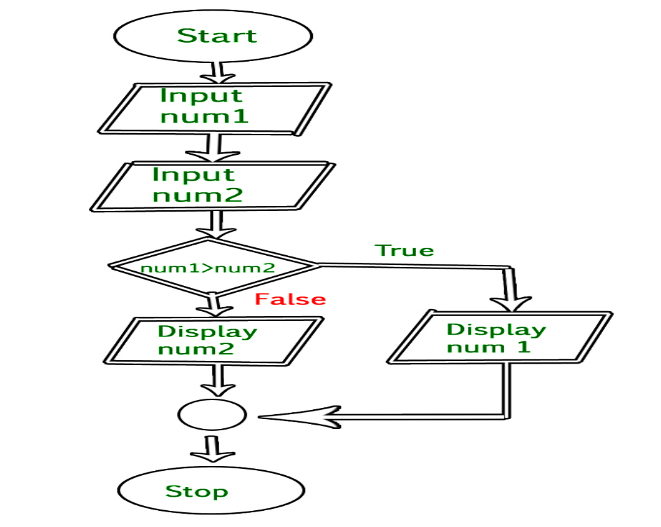
Algorithm Design
Example: Flow Chart
Question: What is the purpose of this Flow Chart ? What does it do ?

Slide 9
Algorithm Design
Writing Algorithms Using Pseudo Code
All identifier names used in pseudocode should be meaningful;
For example, the name of a person could be stored in the variable identified by Name.
Identifiers should also follow some basic rules: they should only contain the characters A–Z, a–z and 0–9, and should start with a letter.
Pseudocode identifiers are usually considered to be case insensitive, unlike identifiers used in a programming language.

Slide 10
Algorithm Design
Writing Algorithms Using Pseudo Code
It is good practice to keep track of any identifiers used in an identifier table.
Identifier Name | Description
StudentName | Store a Student Name
Counter | Store a loop counter
StudentMark | Store a student mark

Slide 11
Algorithm Design
Writing Algorithms Using Pseudo Code
Example of a Pseudo-Code Input Statement:
INPUT StudentName
Example of a Pseudo-Code Output Statement:
OUTPUT "You have made an error"
OUTPUT StudentName
OUTPUT "Student name is ", StudentName

Slide 12
Algorithm Design
Writing Algorithms Using Pseudo Code
Pseudo-codes to assign a value to a variable (the value can be the result of a process or a calculation):
Counter ← 1
Counter ← Counter + 1
MyChar ← "A"
LetterValue ← ASC(MyChar)
StudentMark ← 40
Percentage ← (StudentMark / 80) * 100
Oldstring ← "Your mark is"
NewString ← OldString & " ninety-seven"

Slide 13
Algorithm Design
Writing Algorithms Using Pseudo Code
Operators used in pseudocode assignment statements::
+ Addition
- Subtraction
* Multiplication
/ Division
& String concatenation
← Assignment

Slide 14
Algorithm Design
Writing Algorithms Using Pseudo Code
Selection using IF statements (single choice):
IF MyValue > YourValue
THEN
OUTPUT "I win"
ENDIF

Slide 15
Algorithm Design
Writing Algorithms Using Pseudo Code
Selection using IF statements (single choice with alternative):
IF MyValue > YourValue
THEN
OUTPUT "I win"
ELSE
OUTPUT "You win"
ENDIF

Slide 16
Algorithm Design
Writing Algorithms Using Pseudo Code
Selection using CASE statements (multiple choices):
CASE OF Direction
"N": Y ← Y + 1
"S": Y ← Y – 1
"E": X ← X + 1
"W": X ← X – 1
ENDCASE

Slide 17
Algorithm Design
Writing Algorithms Using Pseudo Code
Selection using CASE statements (multiple choices with alternative):
CASE OF Direction
"N": Y ← Y + 1
"S": Y ← Y – 1
"E": X ← X + 1
"W": X ← X – 1
OTHERWISE : OUTPUT "Error"
ENDCASE

Slide 18
Algorithm Design
Writing Algorithms Using Pseudo Code
Relational Operators used in selection statements::
= Equal to
<> Not equal to
> Greater than
> Less than
>= Greater than or equal to
<= Less than or equal to

Slide 19
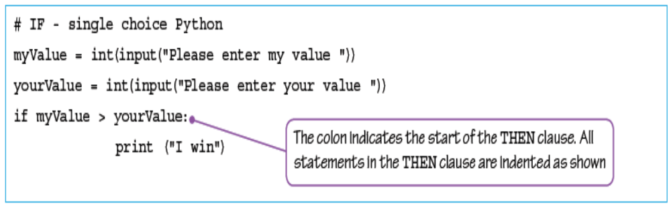
Algorithm Design
Writing Algorithms Using Pseudo Code
If Selection (Single Choice) Using Python:

Slide 20
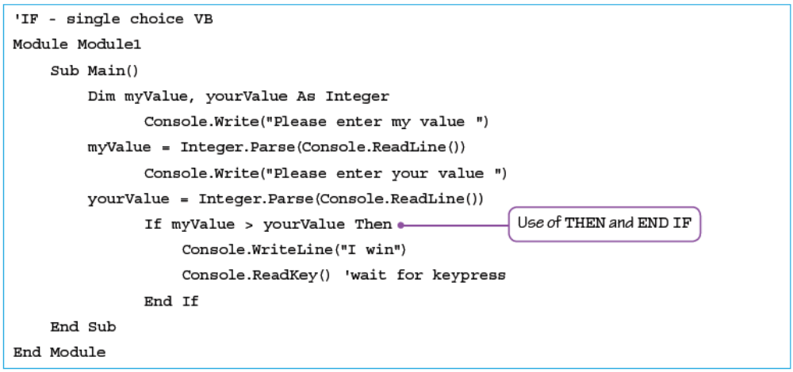
Algorithm Design
Writing Algorithms Using Pseudo Code
If Selection (Single Choice) Using Visual Basic (VB):

Slide 21
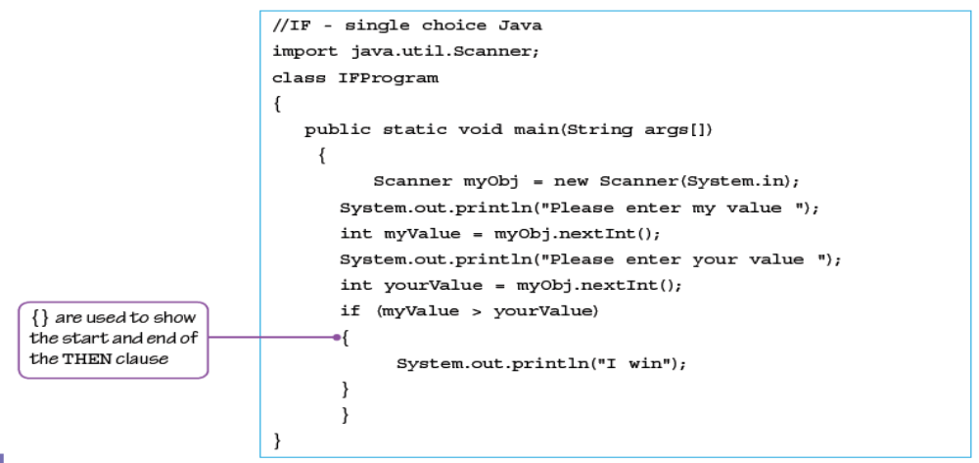
Algorithm Design
Writing Algorithms Using Pseudo Code
If Selection (Single Choice) Using Java:

Slide 22
Algorithm Design
Writing Algorithms Using Pseudo Code
Iteration (Loop) Using FOR Keyword:
Total ← 0
FOR Counter ← 1 TO 10
OUTPUT "Enter a number "
INPUT Number
Total ← Total + Number
NEXT Counter
OUTPUT "The total is ", Total

Slide 23
Algorithm Design
Writing Algorithms Using Pseudo Code
Iteration (Loop) Using FOR Keyword with STEP Increment:
FOR Counter ← 1 TO 10 STEP 2
OUTPUT Counter
NEXT Counter
Note: The value of Counter will be: 1, 3, 5, 7, 9.

Slide 24
Algorithm Design
Writing Algorithms Using Pseudo Code
Iteration (Loop) Using REPEAT-UNTIL Keyword:
REPEAT
OUTPUT "Please enter a positive number "
INPUT Number
UNTIL Number > 0
Note: Statements in a REPEAT loop are always executed at least once.

Slide 25
Algorithm Design
Writing Algorithms Using Pseudo Code
Iteration (Loop) Using WHILE Keyword:
Number ← 0
WHILE Number >= 0 DO
OUTPUT "Please enter a negative number "
INPUT Number
ENDWHILE
Note: Statements in a WHILE loop may sometimes not be executed..

Slide 26
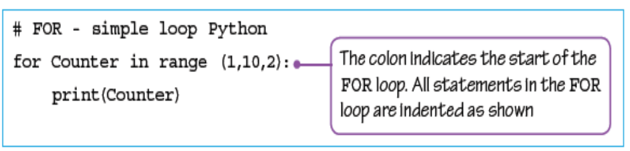
Algorithm Design
Writing Algorithms Using Pseudo Code
For Loop Using Python:
Note: The value of Counter will be: 1, 3, 5, 7, 9

Slide 27
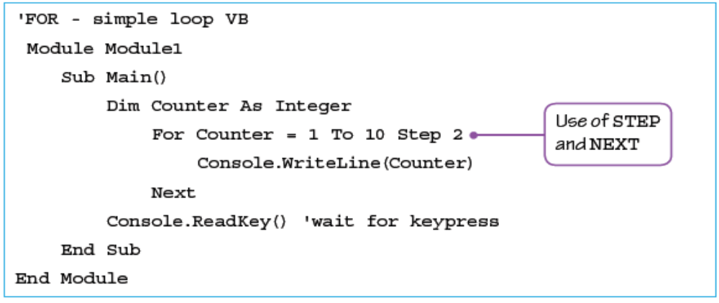
Algorithm Design
Writing Algorithms Using Pseudo Code
For Loop Using Visual Basic (VB):
Note: The value of Counter will be: 1, 3, 5, 7, 9

Slide 28
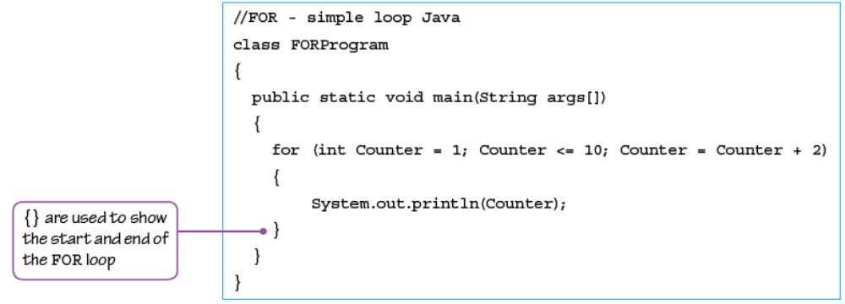
Algorithm Design
Writing Algorithms Using Pseudo Code
For Loop Using Java:
Note: The value of Counter will be: 1, 3, 5, 7, 9

Slide 29
Algorithm Design
Writing Algorithms Using Pseudo Code
For Loop Using Java:
Note: The value of Counter will be: 1, 3, 5, 7, 9

Slide 30
Algorithm Design
Class Activity
Algorithms can be shown as structured English, flowcharts and pseudocode.
Explain what is meant by:
  structured English
  a flowchart
  pseudocode

Slide 31
Algorithm Design
Writing Pseudocode from Structured English Description
The wording just needs to be unambiguous and easily understandable when writing Pseudo code from Structured Engish.
From structured English description,the following has to be made possible:
  Any variables that need to be used can be identified and put in an identifier table – these can be items input or output as the results of calculations.
  Input and output can be identified from the wording used, for example, Enter, Read, Print, Write.
  Selection can be identified from the wording used, for example, If, Then, Choose.
  Any iteration required can be identified from the wording used, for example, Loop, Repeat.
  Any processes needed can be identified from the wording used, for example, Set, Calculate.

Slide 32
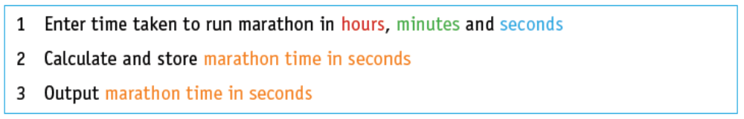
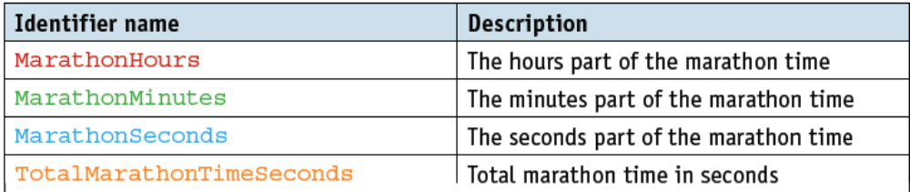
Algorithm Design
Writing Pseudocode from Structured English Description
Example:
An algorithm to calculate a runner’s marathon time in seconds, using structured English.
Identify the .variables required and complete the identifier table

Slide 33
Algorithm Design
Writing Pseudocode from Structured English Description
Pseudo Code to Calculate Marathon Time:
OUTPUT "Enter the time you took to run the marathon"
OUTPUT "Enter hours"
INPUT MarathonHours
OUTPUT "Enter minutes"
INPUT MarathonMinutes
OUTPUT "Enter seconds"
INPUT MarathonSeconds
TotalMarathonTimeSeconds ← (MarathonHours * 3600 + MarathonMinutes) * 60 + MarathonSeconds
OUTPUT "Time for marathon in seconds ", TotalMarathonTimeSeconds

Slide 34
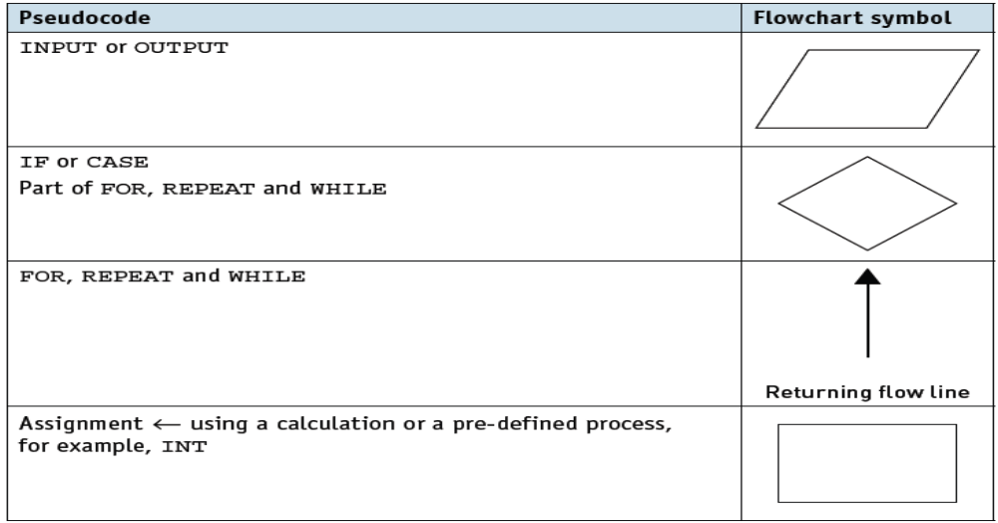
Algorithm Design
Writing Pseudocode from Flow Chart
Flowcharts are diagrams showing the structure of an algorithm using an agreed set of symbols.

Slide 35
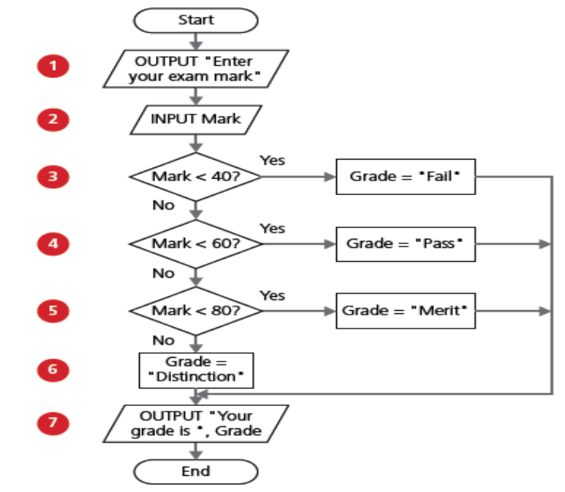
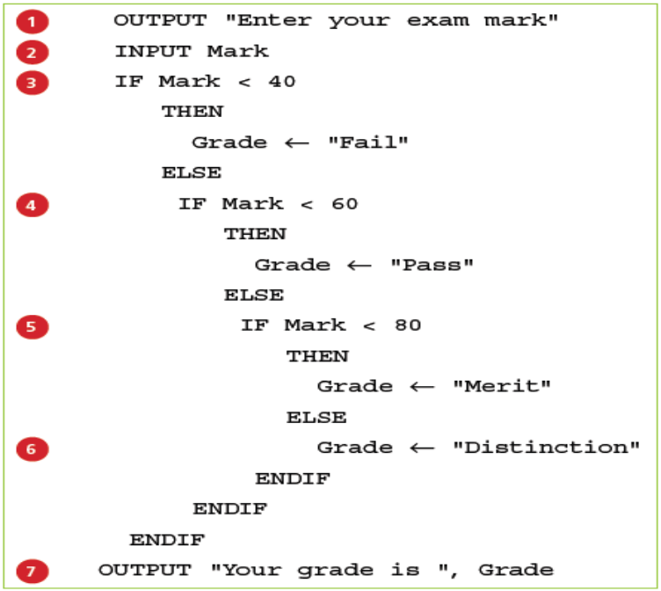
Algorithm Design
Writing Pseudocode from Flow Chart
Flowcharts can be used to identify any variables required and you can then complete an identifier table.
Each flowchart symbol can be used to identify and write one or more pseudocode statements.
An example of a flowchart of an algorithm that can be used to check an exam grade (left figure) and the Pseudo Code (right).

Slide 36
Algorithm Design
Stepwise Refinement
When an algorithm is written to solve a more complex problem, decomposition is used to break the problem down into smaller and more manageable parts.
These parts then need to be written as a series of steps where each step can be written as a statement in a high-level programming language.
This process is called stepwise refinement.

Slide 37
Algorithm Design
Stepwise Refinement
Look at the first step of the structured English to calculate a time in seconds.
1 Enter time taken to run marathon in hours, minutes and seconds
2 Calculate and store marathon time in seconds
3 Output marathon time in seconds
The first step can be further broken down, as follows:
1.1 Enter the hours
1.2 Enter the minutes
1.3 Enter the seconds

Slide 38
Algorithm Design
Stepwise Refinement
Each of the steps (in previous slide) can be broken down further:
1.1.1 Input value for hours
1.1.2 Check input in the range 2 to 8
1.1.3 Reject if out of range or not a whole number and re-input value step 1.1.1
1.1.4 Accept and store value in hours
1.2.1 Input value for minutes
1.2.2 Check input in the range 0 to 59
1.2.3 Reject if out of range or not a whole number and re-input value step 1.2.1
1.2.4 Accept and store value in minutes
1.3.1 Input value for seconds
1.3.2 Check input in the range 0 to 59
1.3.3 Reject if out of range or not a whole number and re-input value step 1.3.1
1.3.4 Accept and store value in seconds

Slide 39
Algorithm Design
Stepwise Refinement
These steps can now be written in pseudocode.
For example, the input routine for the seconds:
REPEAT
OUTPUT "Enter seconds"
INPUT Value
UNTIL (Value >= 0) AND (Value <= 59) AND (Value = INT(Value))
MarathonSeconds ← Value

Slide 40
Algorithm Design
Class Activity 2
Tickets are sold for a concert at $20 each. If 10 tickets are bought then the discount is 10%; if 20 tickets are bought the discount is 20%. No more than 25 tickets can be bought in a single transaction.
Use pseudocode to write an algorithm to calculate the cost of buying a given number of tickets.

